Slide 1
Molecular Biology Laboratory BT 453
Laboratory No. 6
Restriction Endonucleases

Slide 2
OBJECTIVES
To understand the origin & natural function of restriction enzymes (RE)
To have an idea about the Restriction/Modification Systems in bacteria
To understand the different experimental uses of RE

Slide 3

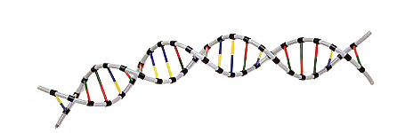
Restriction Endonucleases
Restriction enzyme
A protein that recognizes a particular sequence of DNA and cuts the DNA at that site (the restriction site)
Isolated from bacteria as endogenous “restrictors” of bacterial pathogens
Called "restriction enzymes“ because restrict host range for certain bacteriophage
Bacterial" immune system": destroy any "non-self" DNA
MBL. BT453

Slide 4
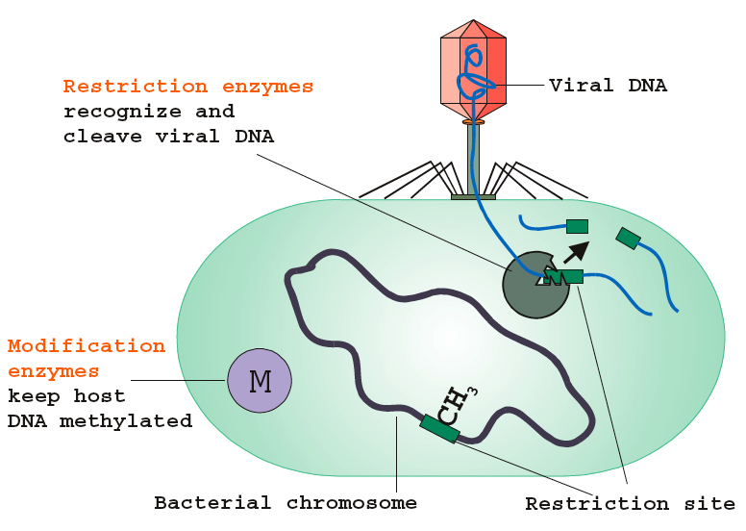
Bacterial immune system
MBL. BT453

Slide 5
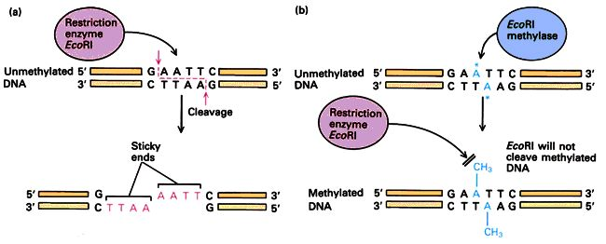
Restriction Enzymes
Methylase recognizes same sequence in host DNA and protects it by methylating it; restriction enzyme destroys unprotected = non-self DNA
(Restriction/Modification Systems)
MBL. BT453
5

Slide 6
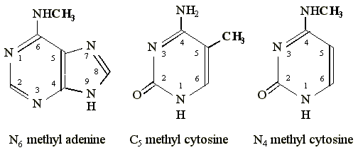
Methylation
Typical sites of methylation include the N6 position of adenine, the N4 position of cytosine, or the C5 position of cytosine.
Methylation occures at very specific sites in the DNA
MBL. BT453

Slide 7
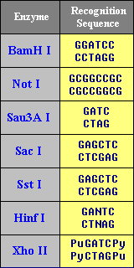
Function
Restriction enzymes recognize and make a cut within specific Palindromic Sequences, known as Restriction Sites, in the DNA.
Palindromic sequence
DNA sequence in which the 5’ to 3’ base pair sequence is identical on both strands.
Different enzymes
Different restriction sites
Different cuts
http://arbl.cvmbs.colostate.edu/
MBL. BT453

Slide 8
Examples of RE
Name | Source | Recognition Sequence | Comments
Alu I | Arthrobacter luteus | | 5'… A G C T … 3' 3'… T C G A … 5' | | "Four cutter". Leaves blunt ends to the DNA.
Bfa I | Bacteroides fragilis | | 5'… C T A G … 3' 3'… G A T C … 5' | | "Four cutter". Leaves 5' overhang.
Eco R1 | Escherichia coli | | 5'… G A A T T C … 3' 3'… C T T A A G … 5' | | "Six cutter". Leaves 5' overhang.
Hae II | Haemophilus aegyptius | | 5'… Pu G C G C Py … 3' 3'… Py C G C G Pu … 5' | | "Six cutter". Pu is any purine, Py is any pyrimidine. Leaves 3' overhang.
Bgl I | Bacillus globigii | | 5'… GCCN NNNNGGC … 3' 3'… CGGNNNN NCCG … 5' | | "Six cutter with interrupted palindrome". Leaves 5' overhang.
MBL. BT453

Slide 9
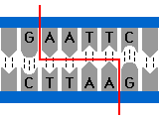
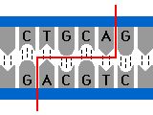
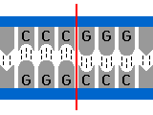
Cutting Position
http://www.phschool.com/science/
http://www.phschool.com/science/
http://www.phschool.com/science/
Eco RI
Pst I
Sma I
MBL. BT453

Slide 10
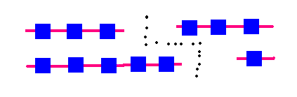
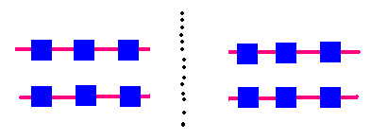
Types of Cuts
Blunt end Cutters
Sticky-end Over-hangers
MBL. BT453

Slide 11
Types of Enzymes
Type I
Multi-non-identical subunits, both endonuclease and methylase activities, cleave at random up to 1000 bp from recognition sequence
Mwt: 300.000 Da
Cofactors: Mg2+, SAM, ATP
Type II
Most single subunit or Multi-identical subunits, cleave DNA within recognition sequence
Mwt: 20.000-100.000 Da
Cofactors: Mg2+
Type III
Multi-non-identical subunit, endonuclease and methylase about 25 bp from recognition sequence
Mwt: 200.000 Da
Cofactors: Mg2+, ATP
MBL. BT453

Slide 12
Uses of RE
RFLP
Restriction Fragment Length Polymorphism
Molecular diagnostics
Cloning
cDNA library construction
Population studies
MBL. BT453

Slide 13
Example of RFLP
MBL. BT453

Slide 14
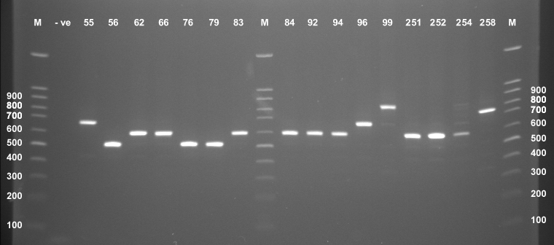
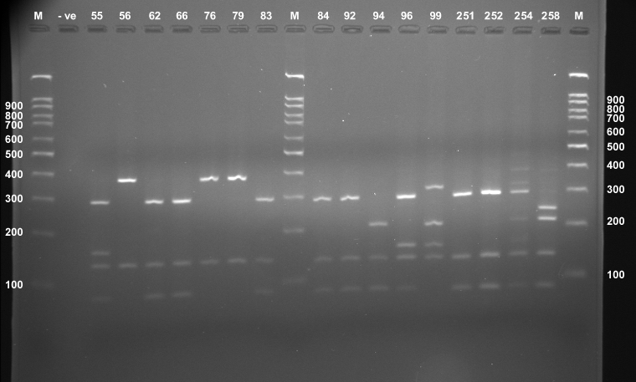
Example of RFLP
Alu I
MBL. BT453

